Slide 1

PENETRATION TESTING

Slide 2
NETWORK THEORY 101

Slide 3
NETWORK THEORY
We cannot talk about ethical hacking and computer security without grasping the basic network concepts.
This module aims to give you an overview and a basic understanding of the main network components, services and protocols.

Slide 4
ISO-OSI MODEL
Each time we mention any network functionality, we are referring to a model called ISO-OSI. What is it and why is it so useful?

Slide 5
ISO-OSI MODEL

Slide 6
RELEVANT CONCEPT
The ISO-OSI model is a theoretical formulation that allows you to identify exactly in which network layer we are operating.

Slide 7
NETWORK THEORY
These layers are:
Application Layer
Presentation Layer
Session Layer
Transport Layer
Network Layer
Data Link Layer
Physical Layer

Slide 8
NETWORK THEORY
Layer distinction is conventional (some protocols operate at different layers) but convenient to focus on specific aspects.
Here we will only discuss physical, data link, network, transport and application layer.
Session and Presentation are not very relevant for our purposes and for understanding how the network works.

Slide 9
NETWORK THEORY
Physical Layer: this layer includes everything related to the transfer of data within a specific means of communication (copper, optic fiber or radio wave).

Slide 10
NETWORK THEORY
Data Link Layer: this level has to do with local area networks (LAN). In a LAN, it is necessary to refer to the MAC address of a certain device.
The binding between the MAC address and the IP address (Network layer) is managed through ARP (Address Resolution Protocol) tables.
In Unix shells you can print the ARP table with arp -a
ARP is a cross-layer protocol (data link + network)

Slide 11
NETWORK THEORY
Network Layer: this level focuses on the communication between different networks. In this case, we will mainly use the Internet Protocol (IP).
Transport Layer: this is where data exchanges is actually managed. In this layer we we discuss the two well-known TCP and UDP protocols.
Application Layer: high-level protocols interact with each other at this layer. Some of these protocols include (but are not limited to) HTTP, HTTPS, and FTP

Slide 12
MAC ADDRESS

Slide 13
RELEVANT CONCEPT
The MAC (Media Access Control) address is a 48-bit identifier that is uniquely assigned by the manufacturer of each Ethernet or wireless network card.

Slide 14

NETWORK THEORY
Below is an example of a MAC address:

Slide 15
NETWORK THEORY
This address is fundamental in the world of networks because it allows a machine to be uniquely identified
Identification is only crucial in a local context (typically a LAN).
For this reason, MAC addresses are not used to globally identify a device (they can be fake)
IP addresses are used instead
Every MAC must be assigned an IP address (e.g., via DHCP) for communicating over IP networks

Slide 16
NETWORK THEORY
When one or more devices are connected to a LAN network, they belong to the same subnetwork.
Therefore, each time one needs to communicate with (a device belonging to) another network, it refers to the IP address and not to the MAC address.

Slide 17
NETWORK THEORY
In order to find your device’s MAC address, you can type one of the following commands
unix shell (newer): ip addr
unix shell (older): ifconfig -a
Windows: ipconfig /all

Slide 18
IP ADDRESS

Slide 19
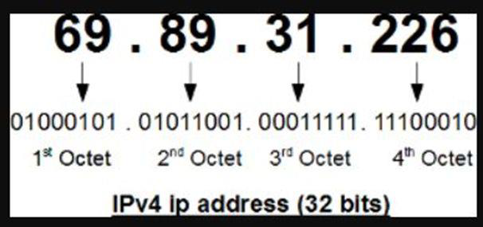
NETWORK THEORY
Below is an example of a IP address:

Slide 20
NETWORK THEORY
The IP address appears as a numeric value of 32 bits and allows the identification of both the network and the host. Basically, we can say that a part of the IP address is intended to identify the network while another one locates the host, which we will introduce later.

Slide 21
NETWORK THEORY
Each time we need to surf the Internet, or communicate with another subnetwork, we must necessarily use a previously assigned IP address.
No machine can browse if it is not provided with an IP address.

Slide 22
NETWORK THEORY
IP addresses are divided into public and private. The public ones allow browsing on the Internet, while the private ones are used inside internal subnetworks (a company's network, for example); no private IP address will ever be able to surf the Internet.

Slide 23
NETWORK THEORY
Let me give you a practical example. Suppose we find ourselves inside a certain local network and that its IP address space is 192.168.1.0/24.
This reads like “all this network’s addresses have the first 24 bits (3 bytes) set to 192.168.1”.
Each connected PC has an IP such as PC1 -> 192.168.1.1, PC2-> 192.168.1.2, PC3 -> 192.168.1.3.

Slide 24
NETWORK THEORY
These are 3 examples of private IP addresses. These machines will always be able to communicate with each other over the same subnet, but they will never be able to do it on the Internet because they do not have a public IP address
Private IP address can be (are!) reused by several subnetworks, otherwise there would be a shortage of IP addresses
2³² ~ 4.3 billion addresses, not that much (IPv6 to the rescue!)

Slide 25
NETWORK THEORY
Private IP addresses are divided into 3 different classes:
Class A private IP addresses where the initial IP address is 10.0.0.0 and the final IP address is 10.255.255.255.
Class B private IP addresses where the initial IP address is 172.16.0.0 and the final IP address is 172.31.255.255.
Class C private IP addresses where the initial IP address is 192.168.0.0 and the final IP address is 192.168.255.255.

Slide 26
NETWORK THEORY
The choice of a specific class depends on the size of our subnet and on how many IP addresses we must assign to the machines.

Slide 27
ARP PROTOCOL

Slide 28
RELEVANT CONCEPT
ARP stands for "Address Resolution Protocol". This protocol keeps track of the association between a MAC address and an IP address.

Slide 29
NETWORK THEORY
Remember that in a local context we need our devices to be identified by a MAC address.
Then, once outside of it, we will communicate exclusively via an IP address.
This context switch is based on mapping that permits to resolve addresses
The mapping is contained in the ARP table, which lists the pairs (MAC-IP).

Slide 30
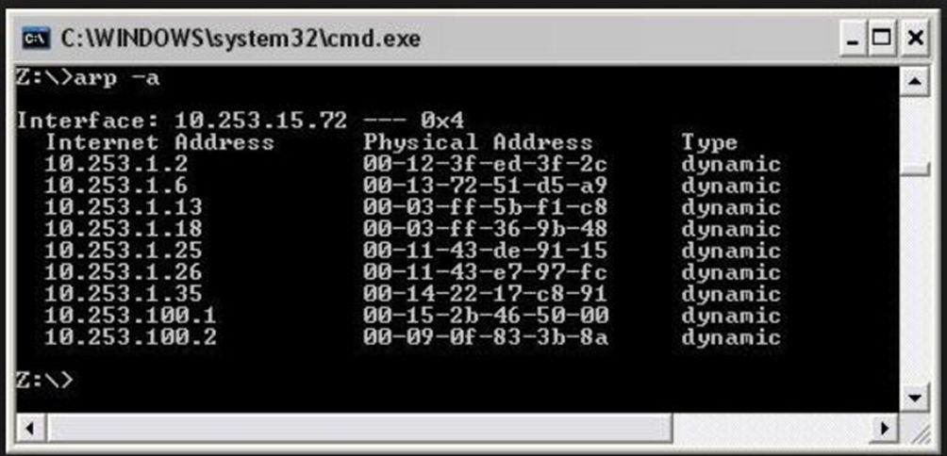
NETWORK THEORY
You can type the "arp -a" command to view the ARP table of a Windows/Unix machine.

Slide 31
DEFAULT GATEWAY

Slide 32
NETWORK THEORY
When you need to communicate within your local network, you will use the ARP protocol, which facilitates the association between a MAC address and an IP address.
However, you will also have to communicate externally, for example on the Internet. At this point, you will need to know exactly what other network devices you are trying to reach, like for example a router.

Slide 33
NETWORK THEORY
This is where the default gateway comes into play. It is the “best device” to use when you need to communicate outside your local network.
Every time your PC does not know how to reach a certain IP, it will ask the default gateway, which will forward the request to the external word.
The IP packet contains the information necessary for this process.

Slide 34
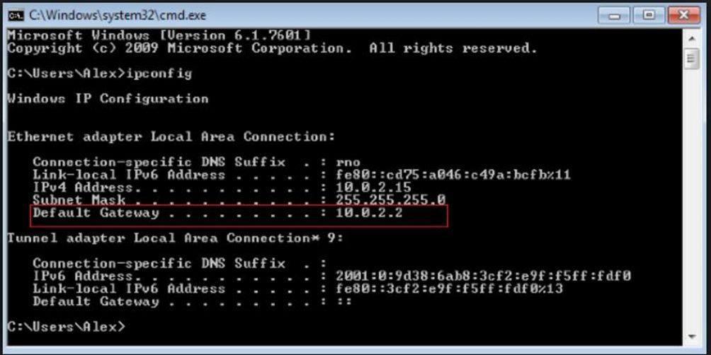
NETWORK THEORY

Slide 35
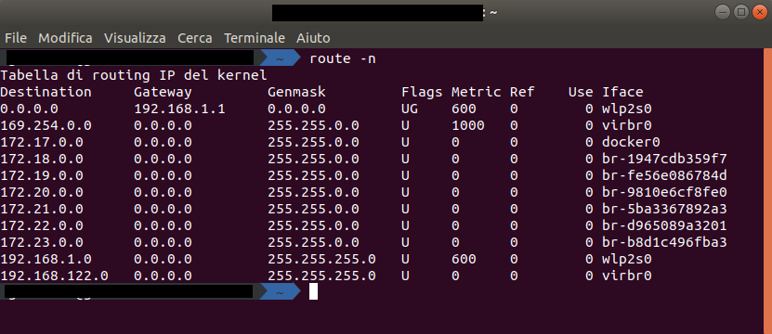
NETWORK THEORY

Slide 36
NETWORK THEORY
In one of the examples, whenever the PC does not know where to send a certain packet that does not belong to its own subnet, it will send it to the default gateway, having address 10.0.2.2.
If you want to know what your default gateway is, you can type the route -n (Unix) or ipconfig (Win)

Slide 37
NAT

Slide 38
NAT
The word NAT stands for “Network Address Translation”. But what does it actually mean?

Slide 39
NETWORK THEORY
When you surf the Internet from home, several things will happen: the first one is that your PC will receive a private IP address, usually belonging to class C (192.168.1.0/24).
However, as you already know, this is not enough to browse on the Internet. You need a public IP address, and this is where your home router and NAT come into play.

Slide 40
NETWORK THEORY
The router will automatically translate the private IP address into a public address and therefore you will be able to navigate without problems.

Slide 41
NETWORK THEORY
PRIVATE IP ADDRESS -> to verify your private IP type the ifconfig or ipconfig command.
PUBLIC IP ADDRESS -> to check your public IP click on the following link: https://www.whatsmyip.org/.

Slide 42
NETWORK THEORY
Let’s imagine that the IP address of your PC is 192.168.1.10. When you try to access the outside network, the router will automatically translate that IP address into a public one, like for example 34.34.23.12.

Slide 43
NETWORK THEORY
The peculiarity of this mechanism is that, if you had ten devices at home each with its own private IP address, they would all be associated with the same public IP address 34.34.23.12.
So, how does the NAT server knows who should receive a response among all the internal IP addresses? By means of the port forwarding: all the IP addresses seems the same from outside, but communications occur on different port numbers.
Only the NAT server knows how to map ports back to IP addresses

Slide 44
NETWORK THEORY
In corporate networks, companies try to reduce the number of public IPs assigned. For this reason, few of these IPs tend to correspond to many private IP addresses for each of the PCs in the network. There are several reasons why this happens.

Slide 45
NETWORK THEORY
The number of IPs is limited and only few of them are still available. This leads to higher prices for each IP address.
Using NAT allows you to create a first layer of network protection/privacy. This means that nobody from outside knows your private IP address. Instead, potential attackers might only be seeing your public IP address without knowing the table of private IP–public IP associations.

Slide 46
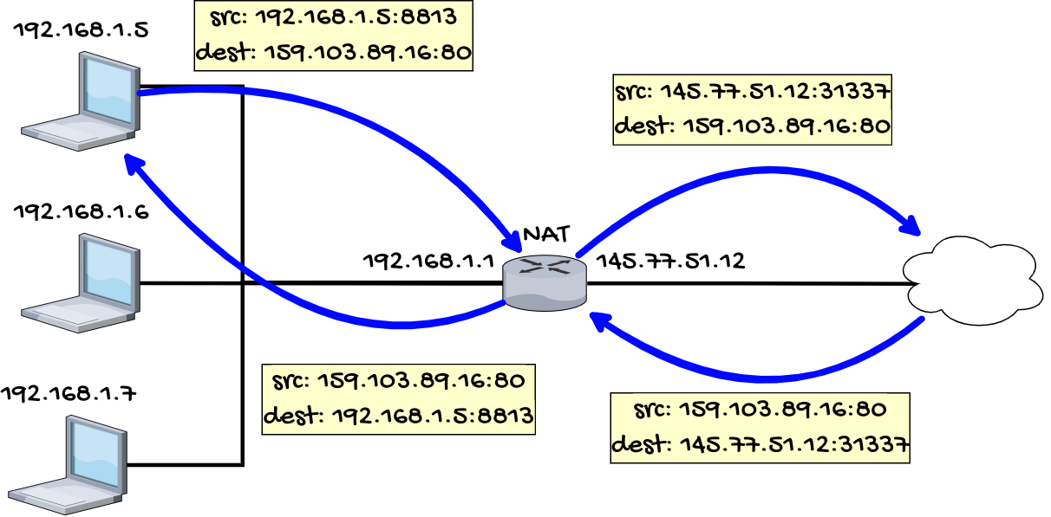

Slide 47
DNS

Slide 48
RELEVANT CONCEPT
The DNS is another essential service of a network.

Slide 49
NETWORK THEORY
IP addresses are not mnemonic and adequate for applications.
For this reason, a mechanism was created to translate a numeric IP address into a line of text (URL), which is easier to understand, remember and manipulate.

Slide 50
NETWORK THEORY
Rather than typing 34.25.7.34 on my browser, I will simply write www.google.com. You will soon realize that without DNS a network could not work, at least based on how we usually mean it.

Slide 51
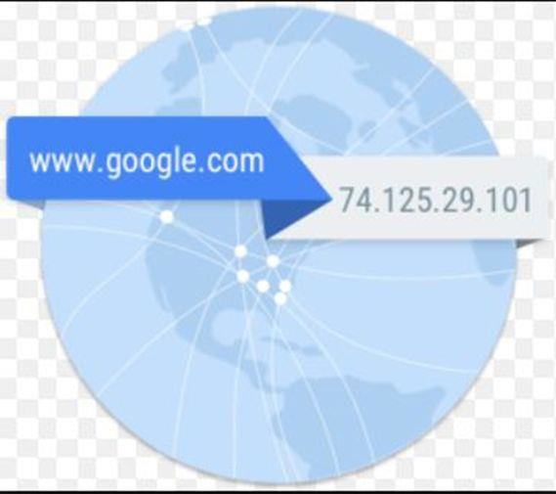
NETWORK THEORY

Slide 52
NETWORK THEORY
We can divide the DNS into two main categories: the public and the private ones. The public ones are meant to resolve the public IP addresses, while the private ones will translate the private IPs.

Slide 53
NETWORK THEORY
Let’s imagine that we are in a company. We need to translate tens of private IP addresses (access to shared folders, access to intranet, etc.). For this reason we need to rely on an internal DNS.
DNS have a hierarchical structure.
When a DNS does not know a response (what IP maps to this url?), it asks the upper level DNS (up to the root level)

Slide 54
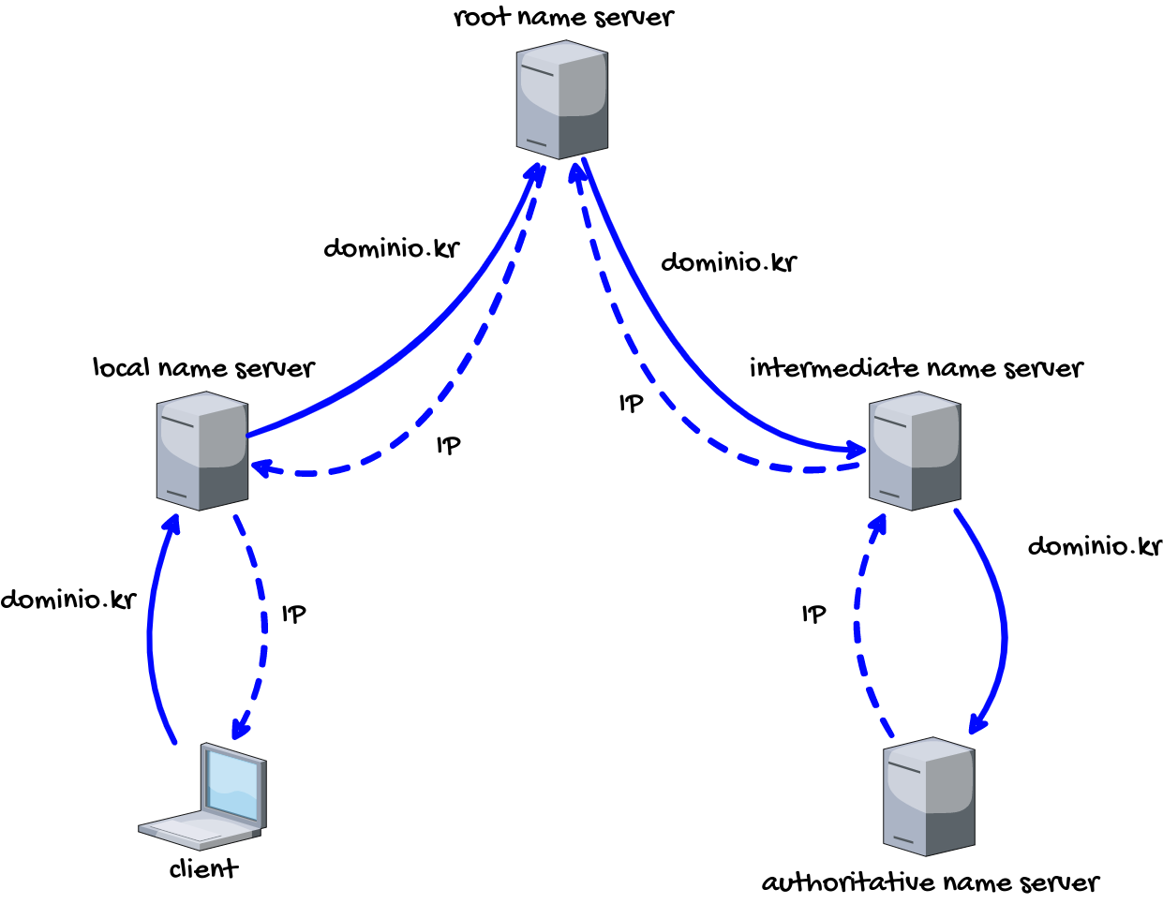

Slide 55
DHCP

Slide 56
NETWORK THEORY
We continue our analysis of the essential network services with the introduction of DHCP (Dynamic Host Configuration Protocol), namely the dynamic IP configuration protocol.

Slide 57
NETWORK THEORY
Let’s imagine we work as system engineers in a company with more than a thousand employees. We should assign to each one of them a private IP address as well as other parameters, like the default gateway and the DNS.
This task is time-consuming and complex (risk of IP collision). A systems engineer must be physically there in the office and assign the parameters to each PC.
Several IP address could be wasted (e.g., host PCs that rarely connect)

Slide 58
NETWORK THEORY
Besides being a considerable waste of time, network changes are not rare and can override the work of network managers.
For all these reasons, a feature was needed to automate this task. That is why the DHCP was created. This protocol automatically assigns all the parameters through a central server that manages the whole network.

Slide 59
NETWORK THEORY
To go into detail, a DHCP can generate two types of network packets:
DHCPDISCOVER. The PC that needs an IP address sends this packet in broadcast hoping for a DHCP server to receive it.

Slide 60
NETWORK THEORY
To go into detail, a DHCP can generate two types of network packets:
DHCPOFFER. When a DHCP server receives a DHCPDISCOVER packet, it tries to satisfy the request and sends a DHCPOFFER packet with all the necessary network parameters to the MAC address of the PC (the IP is obviously still unknown).

Slide 61
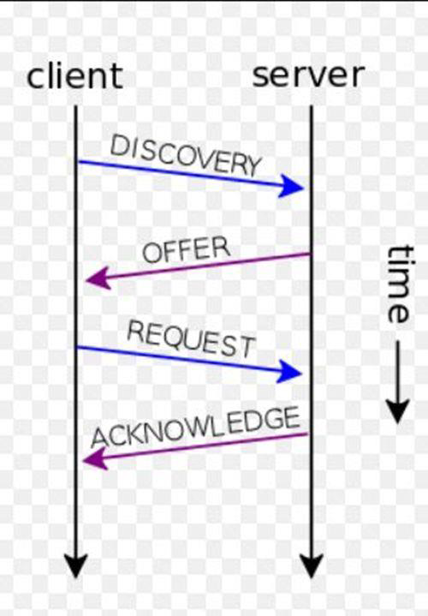
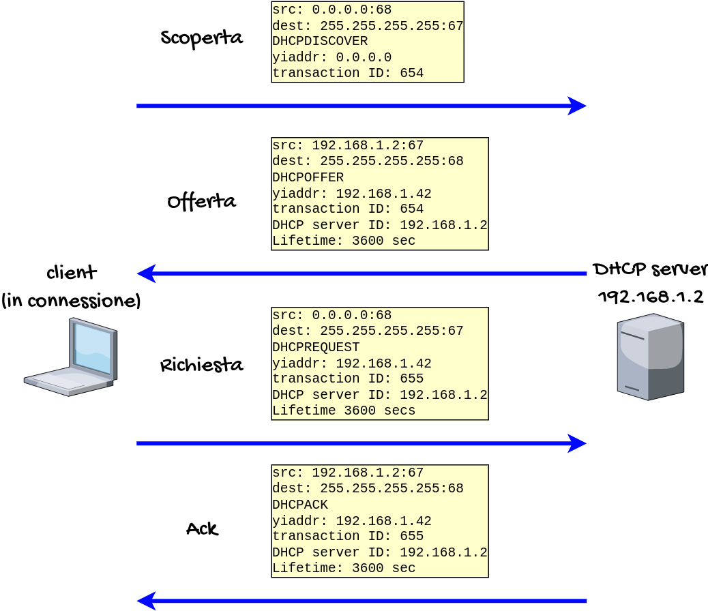
NETWORK THEORY

Slide 62
PORT AND SERVICE

Slide 63
NETWORK THEORY
For a penetration tester, it is necessary to have a clear understanding of the notions of port and service. We will often refer to these concepts in the following chapters related to the work methodology of an ethical hacker.
We can say that both concepts of port and service are closely connected to each other. In order to perform its tasks, any PC needs to establish different types of connections with the outside world.

Slide 64
NETWORK THEORY
There are 65535 ports available but not all of them are used. All the ports up to 1024 are usually dedicated to the most common services. For this reason, they are also called “well-known ports".
For instance, the SSH protocol standard port is 22 and the FTP protocol uses port 21.

Slide 65
NETWORK THEORY
In summary, each service needs a specific port to communicate with and from the outside world. This mechanism will have a strong impact on our actions as a penetration tester.
In fact, a list of the open ports available on a certain PC can provide excellent information and a possible access to this system.

Slide 66
NETWORK THEORY
If we want to see all the active communications you can use the following commands
Windows: netstat -ano
Unix: netstat -tulpn

Slide 67
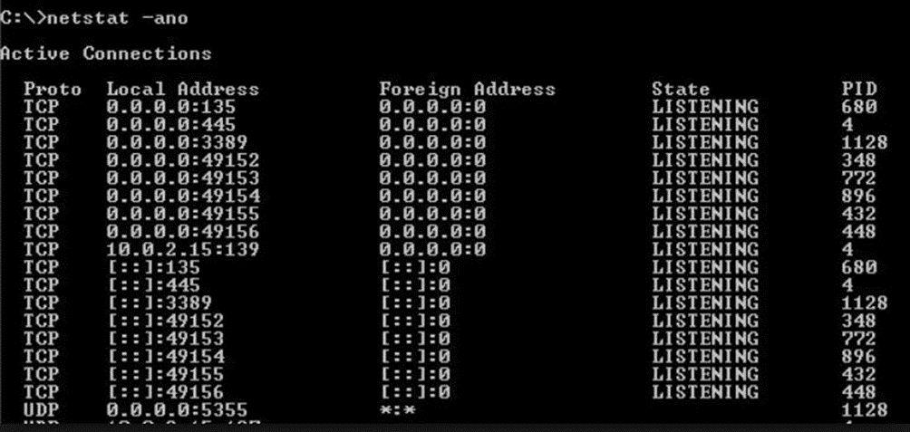
NETWORK THEORY

Slide 68
ARP - PING - TRACEROUTE

Slide 69
NETWORK THEORY
I will now introduce two important commands which will help you in many situations.
I'm referring to the “ARP” and “PING” commands.
The first major distinction between them lays in the layer of the ISO-OSI model in which they operate.

Slide 70
NETWORK THEORY
ARP -> between data link layer (MAC address) and network layer (IP address).
PING -> network layer (IP address).
I will present a working method that can be applied to multiple scenarios.
PROBLEM: a user reports a lack of PC connectivity within the network.

Slide 71
NETWORK THEORY
TROUBLESHOOTING:
Check that the network cable of that PC is in good condition. You can try replacing it. ISO-OSI PHYSICAL LAYER.
Check that the PC has a private IP address assigned. Run the “ifconfig”/“ipconfig” command on the Unix/Windows machine. ISO-OSI NETWORK LAYER.

Slide 72
NETWORK THEORY
TROUBLESHOOTING:
If you do not have direct access to the PC, try using another one to launch the "PING IP-address PC" command where “IP-address PC” is the IP address of the PC. ISO-OSI NETWORK LAYER.
If the PING command does not offer a positive response, execute the ARP command and check the presence of the MAC/IP address association on that PC. ISO-OSI DATA LINK LAYER.

Slide 73
NETWORK THEORY
If the PC does not respond to the PING command but the ARP entry is present, then we might be dealing with a network layer problem. If even the ARP is present, it is then an issue of the data link layer.

